Slide 1
Welcome

Slide 2
“From Zero to SSRF to RCE and back again”
Bsides Basingstoke (2022-07-15) ~ Presented by Thomas Cope

Slide 3





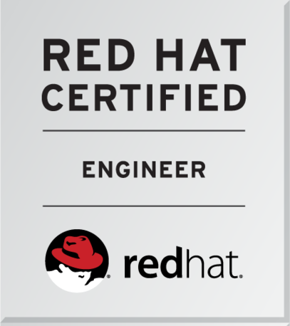
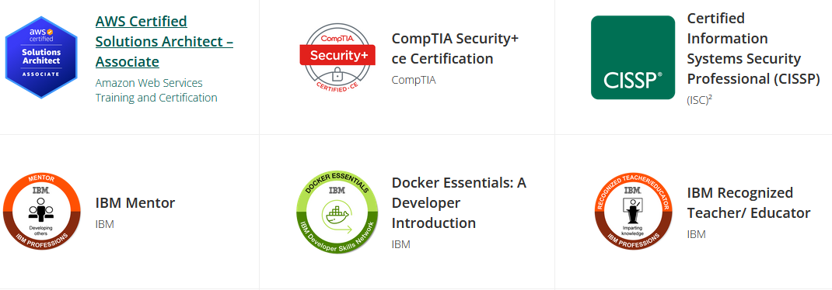
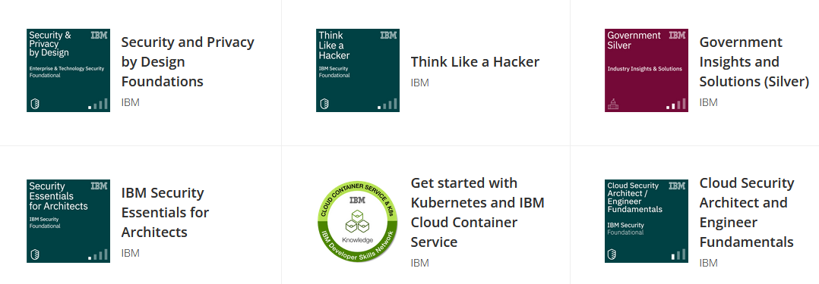
Hello World!
Thomas Cope (https://tomcope.com)
Chief Security Officer (CSO) at Qush Security
Working in Cyber Security ~9 years
MSc in Software and Systems Security
CISSP
Part time Security Researcher (CVE-2020-5014 + CVE-2021-29707)

Slide 4
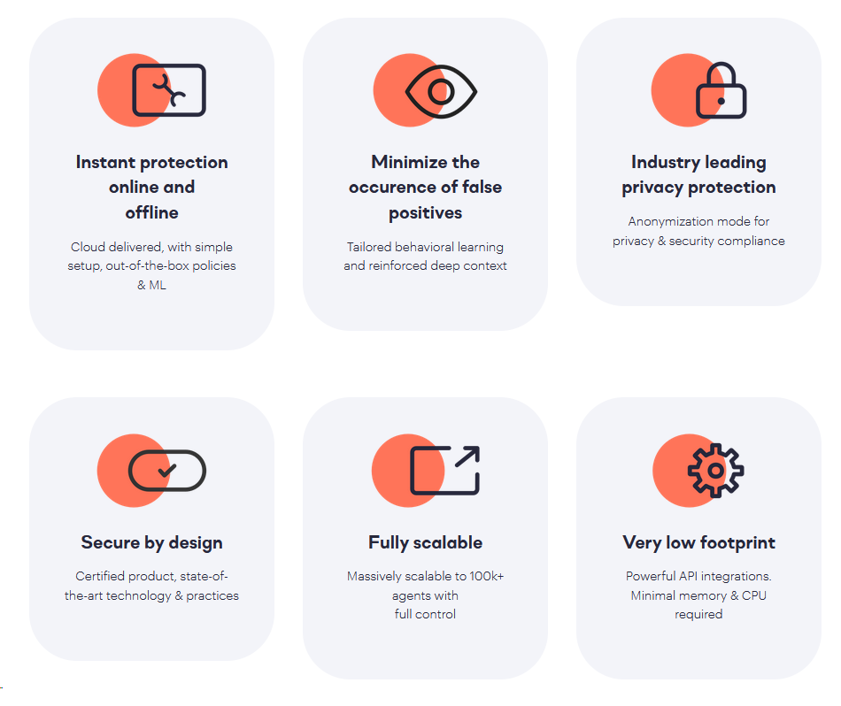
Qush Security
https://www.qush.com
“Enterprise Grade AI Powered Human Centered DLP Solution”
EDR Capability
Extensive policy platform
“If user in dev team uploads source code to their personal gdrive on a work computer then block the upload and display a notification with a link to the AUP where my must provide a business reason to perform another upload”

Slide 5

Qush - Reveal

Slide 6
Enough about me, Lets begin!

Slide 7
What is up with the title?
Security Research Process
Server Side Request Forgery
Remote Code Execution
“From Zero to SSRF to RCE and back again”
Security Research
datapower-redis-rce-exploit (CVE-2020-5014)
Real world impact

Slide 8
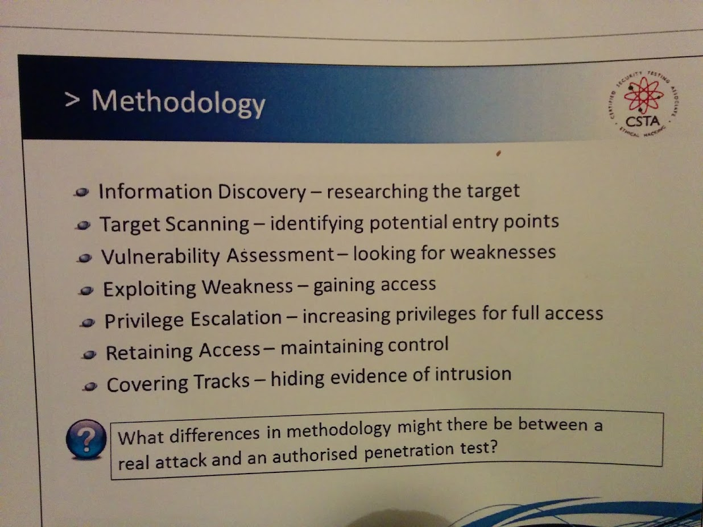
Ethical Hacking Journey - Attackers Mindset

Slide 9
Information Discovery - What are you going to hack?
Pick something fun!
Cool and enjoyable
Relevant to your current role
Easy Access to support, images and documentation
Real world impact
Has a reporting program (HackerOne)
Reward
Monies $£$£$£$£
Credit (CVE)
Hall of Fame - Google
For Fun
Gray hat side (Selling exploits to brokers)
Not Recommended

Slide 10
I picked - IBM Datapower
Pick something fun!
Cool and enjoyable
Relevant to your current role
Easy Access to support,
Images and documentation
Real world impact
Has a reporting program (HackerOne)
Reward
Monies $£$£$£$£
Credit (CVE)
Hall of Fame - Google
For Fun
Gray hat side (Selling exploits to brokers)
Not Recommended

Slide 11
IBM Datapower - Explained
Hardened by design
No Shell access
Can’t access the underlying operating system
Holds really important data like encryption keys
Docker version allows you access to the inner workings
Physical Box is more common
Used in banks to process transactions at high speed
If you forget the password you need to send it back to the factory
Only access it via the GUI + Restricted management interfaces
Designed to be a really tough nut to crack

Slide 12
Making Progress…

Slide 13
Setup
Download
Configure
Look at the webgui
“admin” “admin”
Shodan search???? - Scan the internet
Break into unconfigured docker containers (with approval from system owner, if your doing a pentest)

Slide 14
Target Scanning
Break apart the container and have a look inside, see if we can find a good target!
Anyone know the docker commands?
What’s running?
What’s on the file system?

Slide 15
We have a few Options…
Reverse engineer ”drouter” (ghidra, Ida Pro) - String Search
Web scanning of the WebGUI
Telnet?
SSH?
Redis looks like a good target

Slide 16
Making Progress…

Slide 17
Vulnerability Assessment
Is Redis Vulnerable?
…
…
…
…
Let’s find out!
(127.0.0.1:16379)

Slide 18
Vulnerability Assessment
Info Command
Password needed
Hard Coded Password
Is it hard coded???
Google Redis exploits

Slide 19
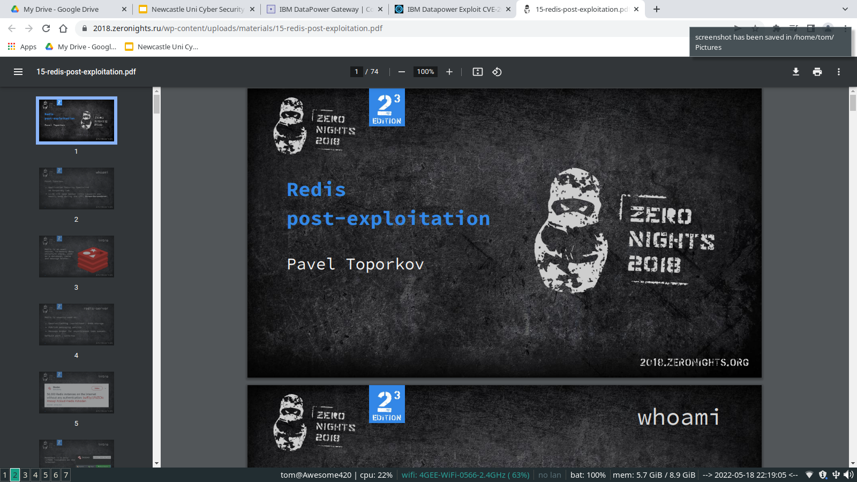
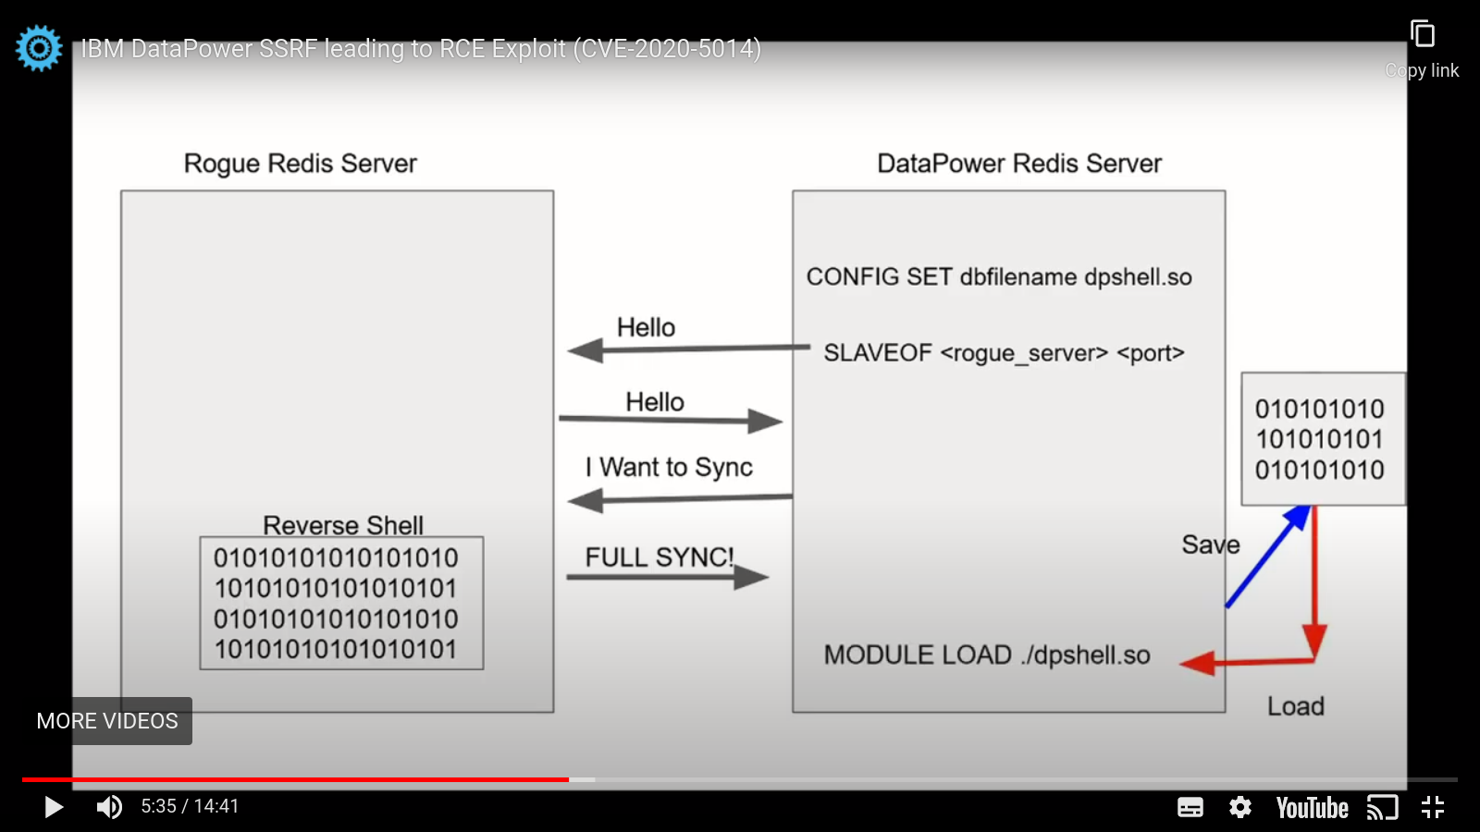
Vulnerability Assessment - Redis RCE

Slide 20
Rogue Redis Exploit
Crazy Powerful exploit
Any Redis server on the internet
Instant Remote Code Execution!
Redis introduced “Protected Mode” by default to help prevent this
Defaults to only listening on localhost
Redis Security guide recommends disabling the use of the “module” command
Do people follow any of this advice or use the “Protected Mode”?
If you Look at Shodan right now -> You’ll find some Vulnerable ones

Slide 21
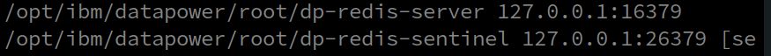
Vulnerability Assessment
Redis looks like a good target! But……… How to talk to it?
127.0.0.1 - Localhost - No external connections
-> Not protected mode - Datapower team hardening

Slide 22
Making Progress…

Slide 23
Exploiting Weakness
We need a SSRF!
https://portswigger.net/web-security/ssrf

Slide 24
What is SSRF?
Server Side Request Forgery
“A Web Security vulnerability that allows an attacker to induce the server-side application to make HTTP requests to an arbitrary domain of the attacker's choosing”
Connecting to itself
Internal Services
Third Party Systems
A Scary class of exploits

Slide 25
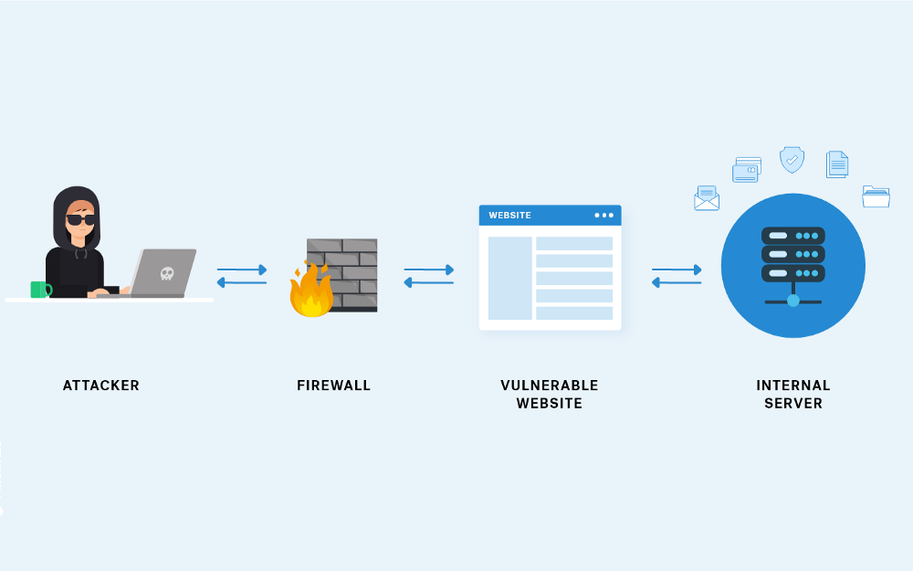
Quick Example
https://app.com/api/v1/webhook?name=test?addr=127.0.0.1
Woops! That not allowed! Should only talk to Websites on the internet! Not itself! Or how about 192.168.0.12 or 10.10.100.12
You put your Database / Redis / Internal systems of a different network, blocked off from the internet but your own application is tricked into sending malicious requests by an attacker

Slide 26
Possible Impacts
Used as a hopping point to attack another company.
Request would originate from a different - Reputation Damage / DDOS
Access to internal APIs / Services
Database endpoints
Authentication services
Redis
Cloud Metadata
Potential access to service accounts credentials
Could then be used to access restricted cloud buckets / databases
K8s
Access to K8s APIs, Secrets, Config Maps
Service accounts for further access to K8s

Slide 27
In the Wild - Exploiting JIRA (CVE-2017–9506)
/plugins/servlet/oauth/users/icon-uri?consumerUri=https://www.attacker.com
AWS - IAM role will leak AWS key
http://169.254.169.254/latest/meta-data/
Docker - List Containers
http://127.0.0.1:2375/v1.24/containers/json
Kubernetes ETCD - Can contain API keys and internal ip and ports
http://127.0.0.1:2379/v2/keys/?recursive=true

Slide 28
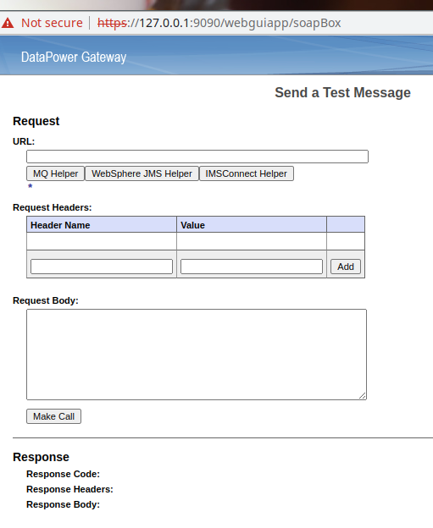
Exploiting Weakness
Hmmm… What’s this?

Slide 29
Exploiting Weakness

Slide 30
Making Progress…

Slide 31
Next Steps
Privilege Escalation
Redis already runs with high privilege
No Principle of least privilege :(
Retaining Access
RCE - easy to add a persistent backdoor / reverse shell
Covering Tracks
Can we make it more sneaky?

Slide 32
Let’s Write the Exploit!
Golang
Standard Library
~2 Hours

Slide 33
Let’s Run It!
Demo Time!

Slide 34
It works!
Zero to SSRF to RCE!
The Scope
Any Datapower
Anywhere on the internet
Only need any form of login (even the lowest level account)
Gain full root access, bypass the restricted environment and run a persistent remote shell
Extract encryption keys that were never meant to leave the device

Slide 35
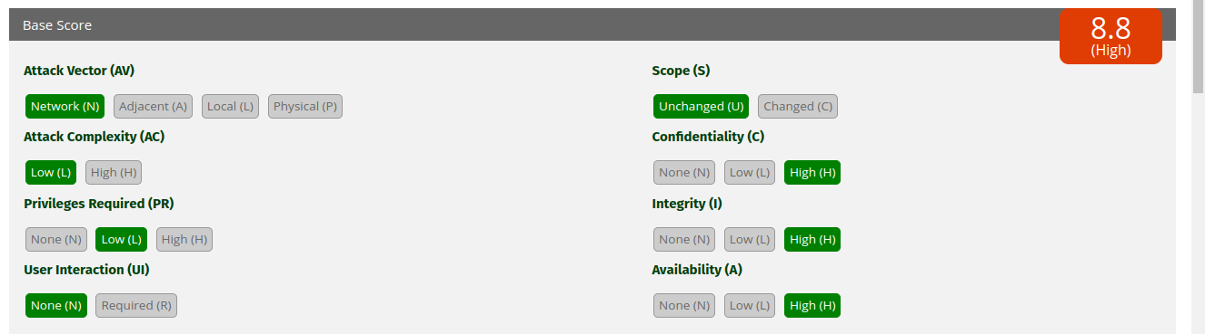
CVE Score - 8.8 (High)
https://www.first.org/cvss/calculator/3.0#CVSS:3.0/AV:N/AC:L/PR:L/UI:N/S:U/C:H/I:H/A:H

Slide 36
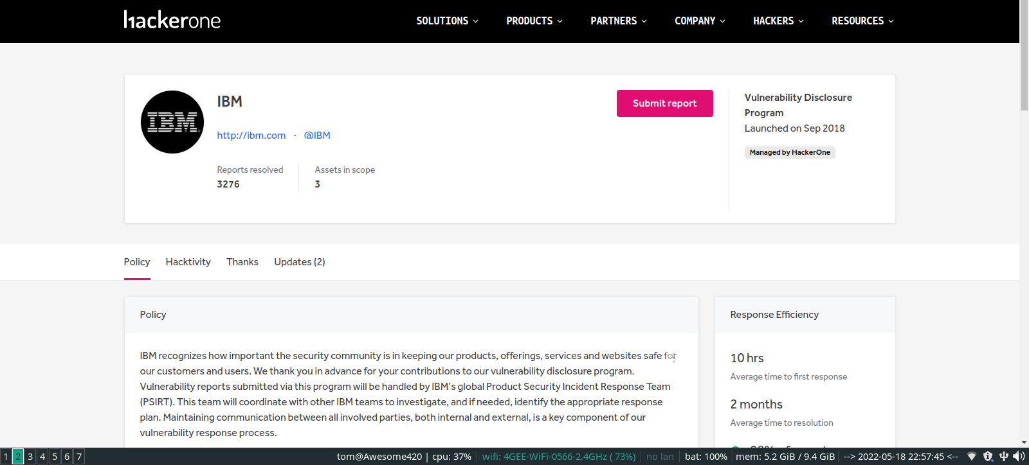
Let’s Report It!

Slide 37
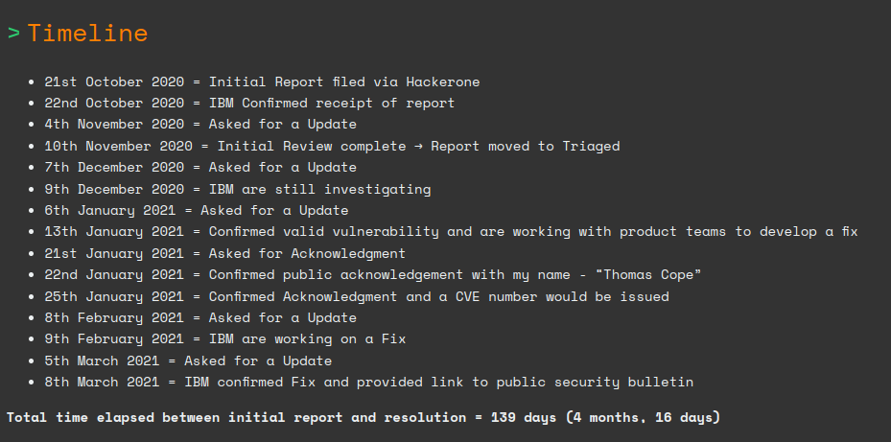
Let’s Report It!
https://tomcope.com/exploit/2020/10/21/ibm-datapower-exploit-cve-2020-5014.html

Slide 38
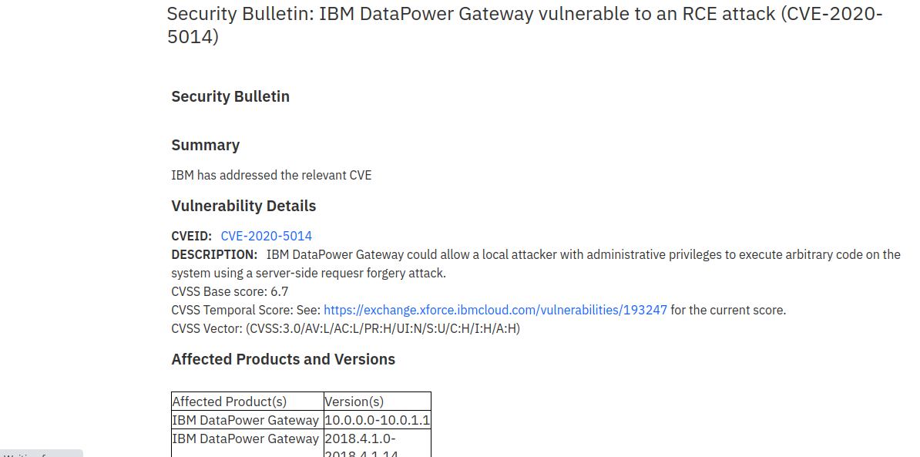
All Worth it! - Fixed and CVE!

Slide 39
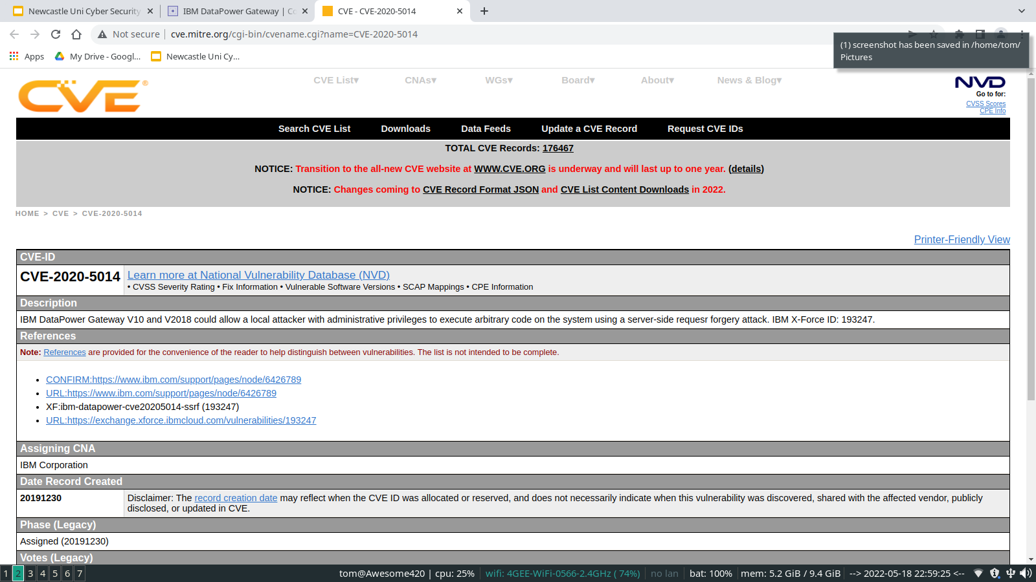
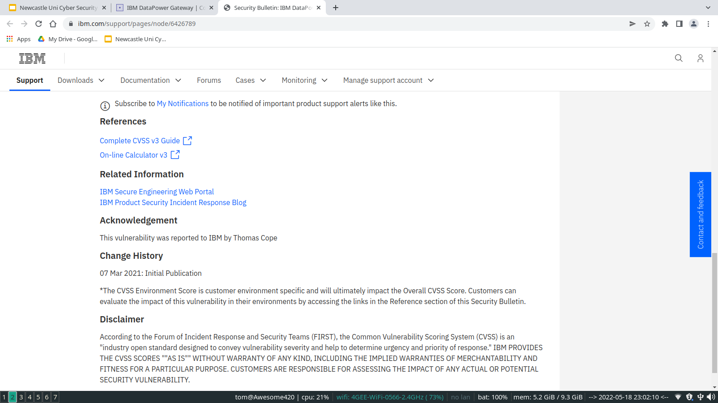
All Worth it! - Fixed and CVE!

Slide 40
The fix
If you are looking for a side project…

Slide 41
The Real World…

Slide 42
Qush Impacted - Customer Pentest
PSIRT 416 - Aware webhooks can make requests against internal components
PSIRT 417 - Cyber internal IP blacklist not configured
PSIRT 418 - Aware webhooks can make requests against cloud components
PSIRT 420 - Video vulnerable to various SSRF attacks
4 Security Issues!

Slide 43
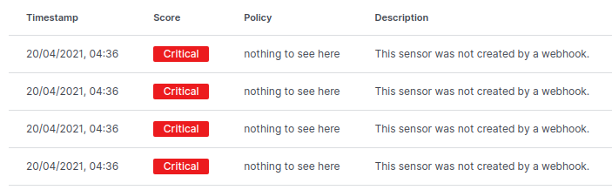
Pentest
Threat Modeling Identified the issue -> Created library to handle checks (with tests + code review) -> Implemented the library -> BUT
On Closer inspection library was not integrated correctly. Integration tests are important!

Slide 44
The Solution
Following Guidance from: https://cheatsheetseries.owasp.org/cheatsheets/Server_Side_Request_Forgery_Prevention_Cheat_Sheet.html
-> Defence in Depth <-
Whitelist domain accessible by the service - Done in code
Network protections - K8s Network Policy + Firewalls
Proactive monitoring of network traffic
Isolation of services
Require authentication to all backend services

Slide 45
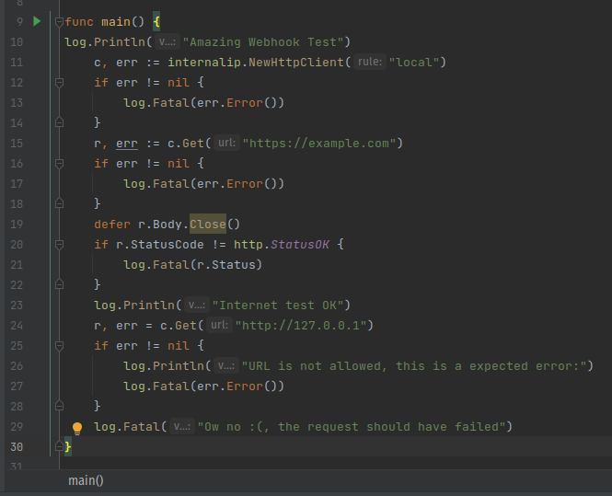
The Solution - Custom Library

Slide 46
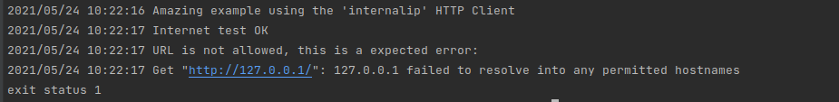
The Solution

Slide 47
My Personal Security Research helped prepare me for handling the incident at work

Slide 48
Before I Close out…

Slide 49
Now Hiring!

Slide 50
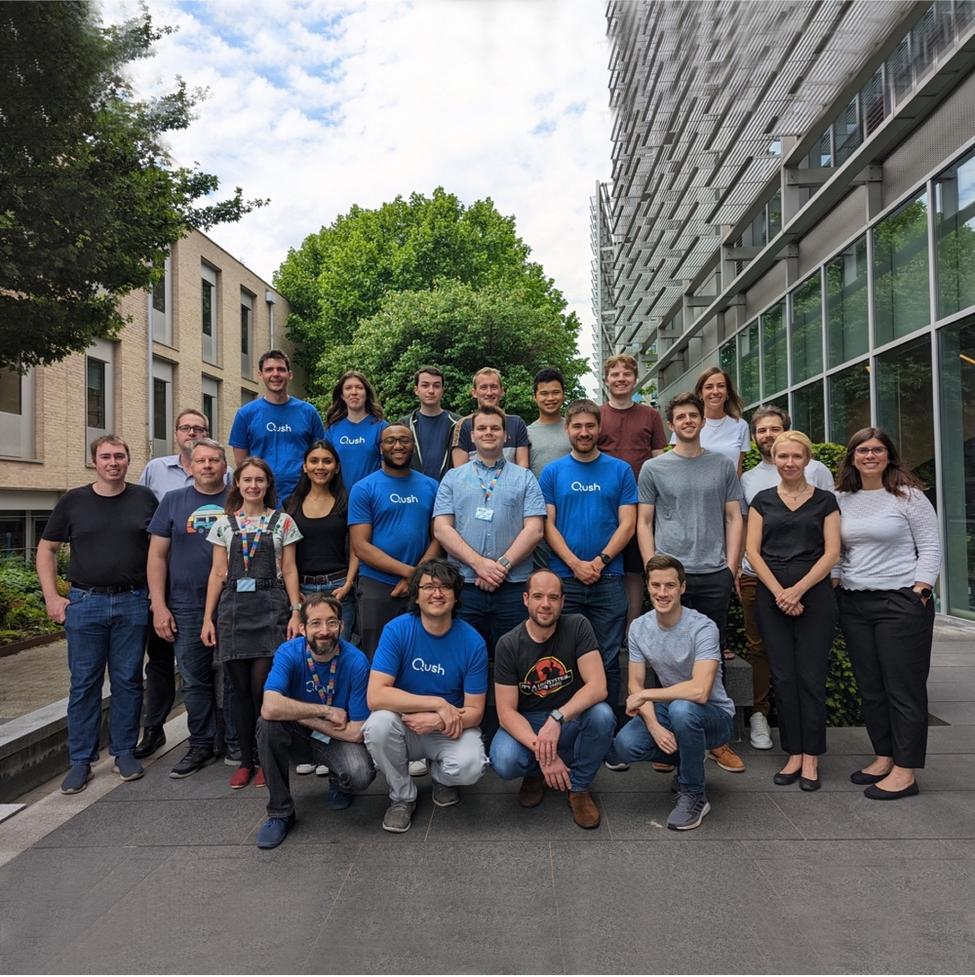

Graduate Software Engineer careers
Test Automation
Cloud architecture / infrastructure
Backend or Frontend
Machine Learning
Data Pipeline
Kernel layer OS systems
Security product development
Go (Golang)
C
C++
C#
Python
Elm
Typescript
Kafka
Kubernetes
Docker
Flink
Spark
GKE
GCP
Postgres
ML
https://www.qush.com/careers
Thankyou! Any Questions?

